Slide 1

Capstone Project

Slide 2



Personal BACKGROUND
Name : Selva Krishnan
Past Experience : Fresher
Qualification : B-TECH CSE with a specialization in Information Security
Career Summary : Developed a strong interest in programming, possessing training knowledge in backend development, Has hands-on experience in building and testing scalable applications, as well as an interest in the current trending field of Generative AI.
www.collaberadigital.com

Slide 3


Key Takeaways/Learnings from the Program (HTD)
Technical Skill Development in Java, Spring Boot, JUnit testing, layered architecture, and microservices, building a strong foundation in backend development.
Gained hands-on experience in developing industry-relevant projects, applying theoretical knowledge to practical scenarios.
Enhanced teamwork and technical communication skills through group projects, code reviews, and presentations.
Acquired practical experience in Agile development, including Scrum practices and project management tools.
Developed advanced analytical skills and debugging techniques for complex software systems.
Cultivated a continuous learning attitude, resilience, and awareness of industry trends essential for long-term career success.

Slide 4

Problem Statement of the Capstone Project
The air transport industry requires an efficient, scalable, and robust software solution to manage its complex operations. Currently, administrators face challenges in effectively handling airport details, plane information, and passenger bookings in a unified system. There is a need for a comprehensive platform that can:
Streamline the management of airports, planes, and bookings through a user-friendly interface.
Ensure secure access with proper authentication mechanisms.
Provide scalability and maintainability through a microservices architecture.
Offer real-time data management and retrieval capabilities.
Implement comprehensive CRUD (Create, Read, Update, Delete) operations for all key entities.
Integrate advanced search functionalities to quickly access and analyze data.
To address these challenges, a Spring Boot-based backend solution with microservices architecture is proposed. This system will consist of five key microservices: Login, Admin, Plane, Airport, and Booking applications. By leveraging Spring Boot, Spring Cloud, and AWS technologies, the solution aims to create a robust, efficient, and scalable Air Transport System that meets the complex demands of modern air transport management.

Slide 5
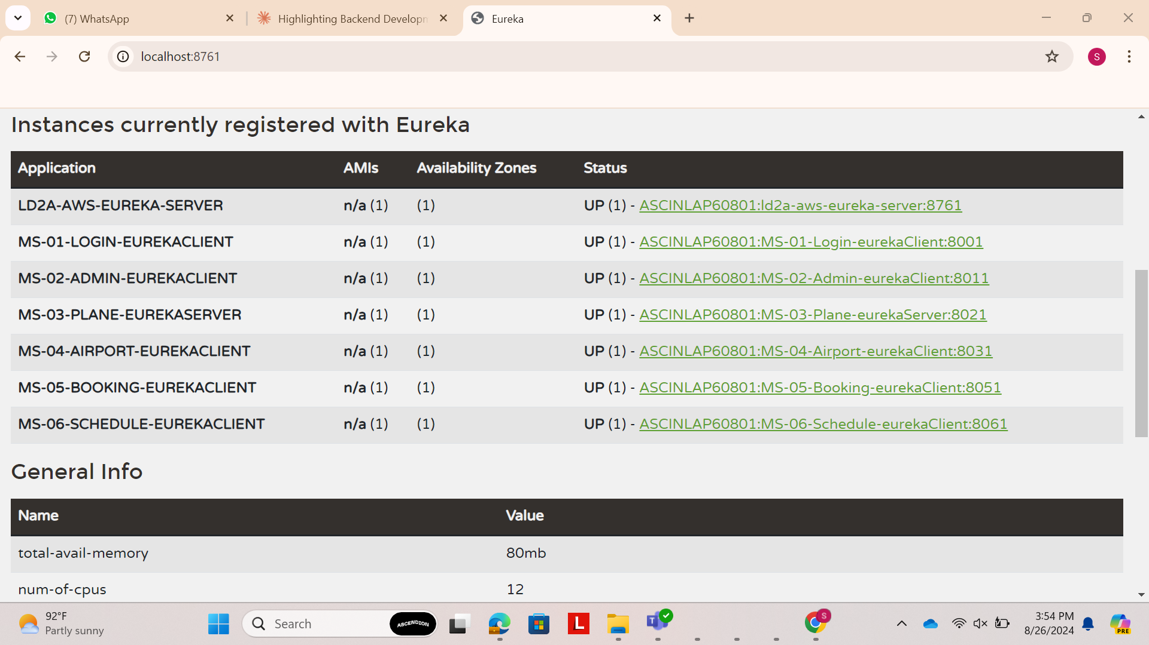
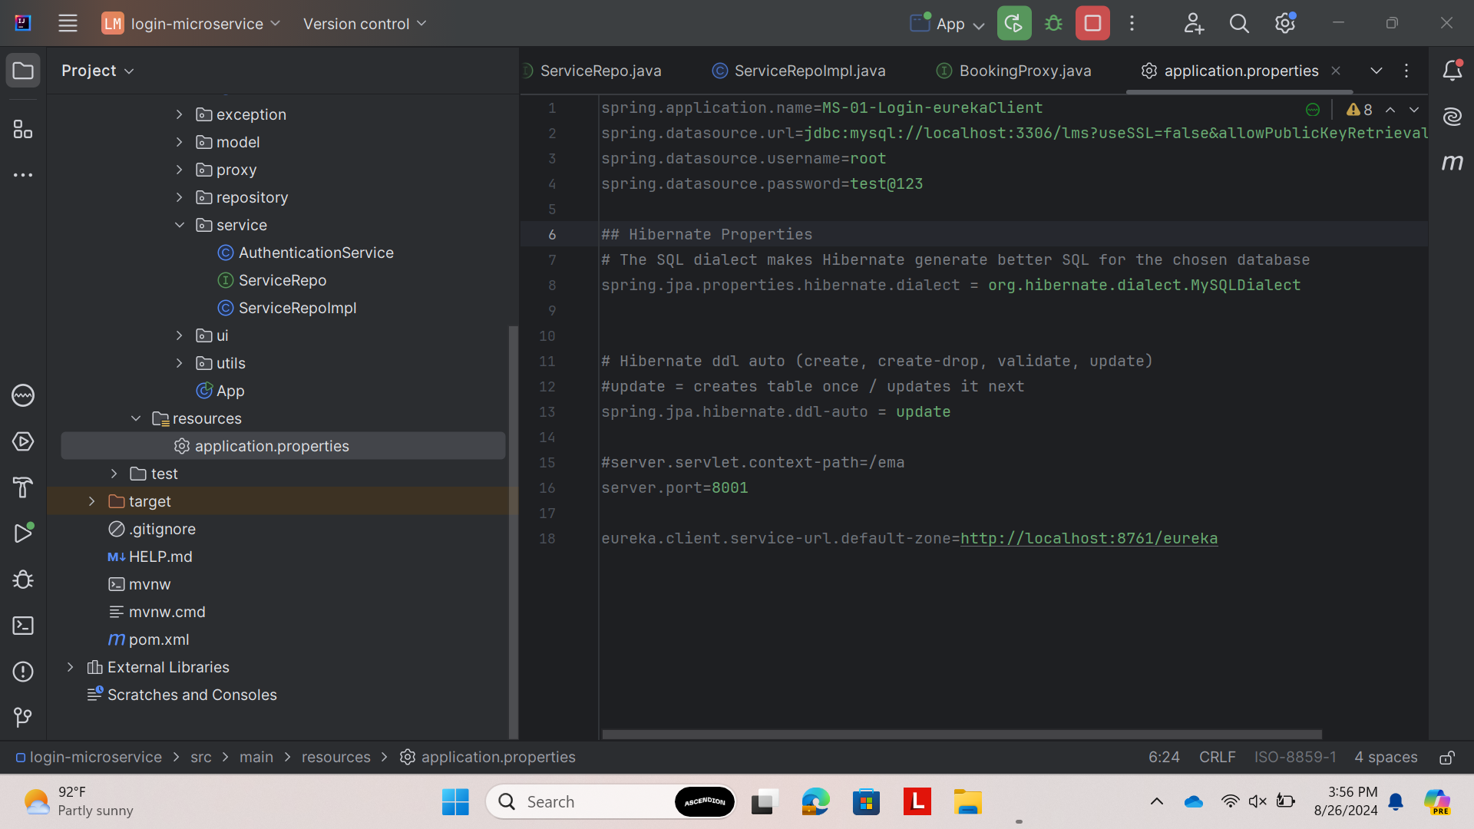
EUREKA

Slide 6
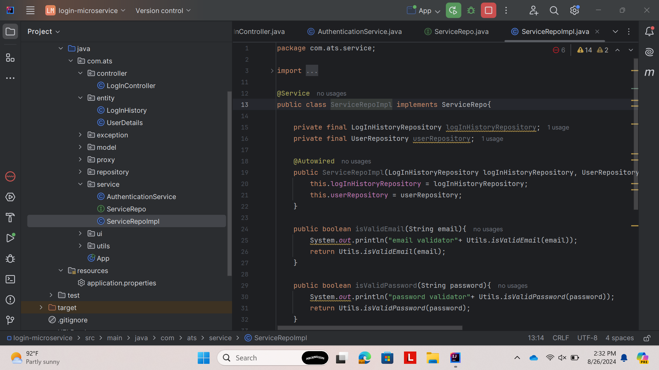
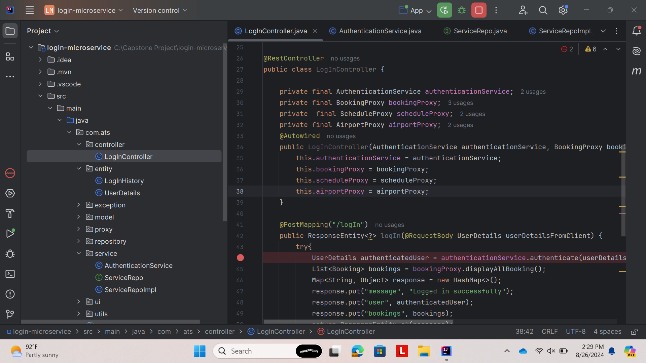
Project Screenshots
LOGIN MICROSERVICES

Slide 7
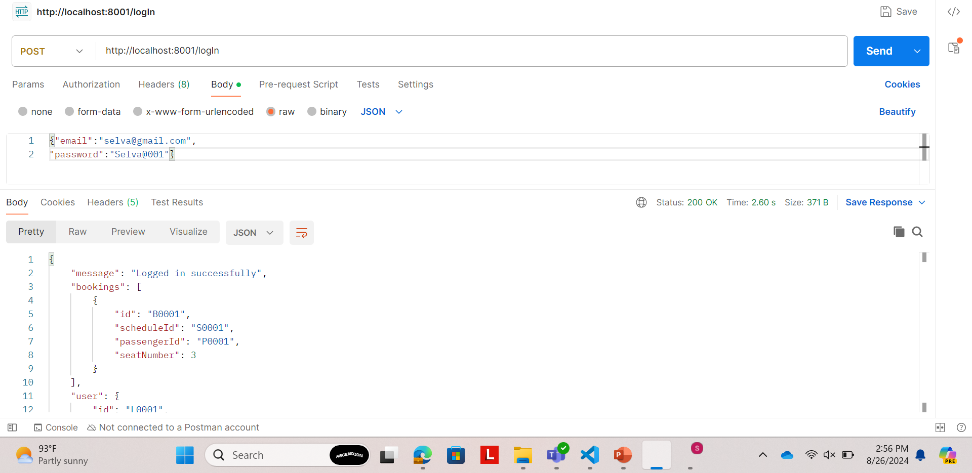
Project Screenshots
LOGIN MICROSERVICES

Slide 8
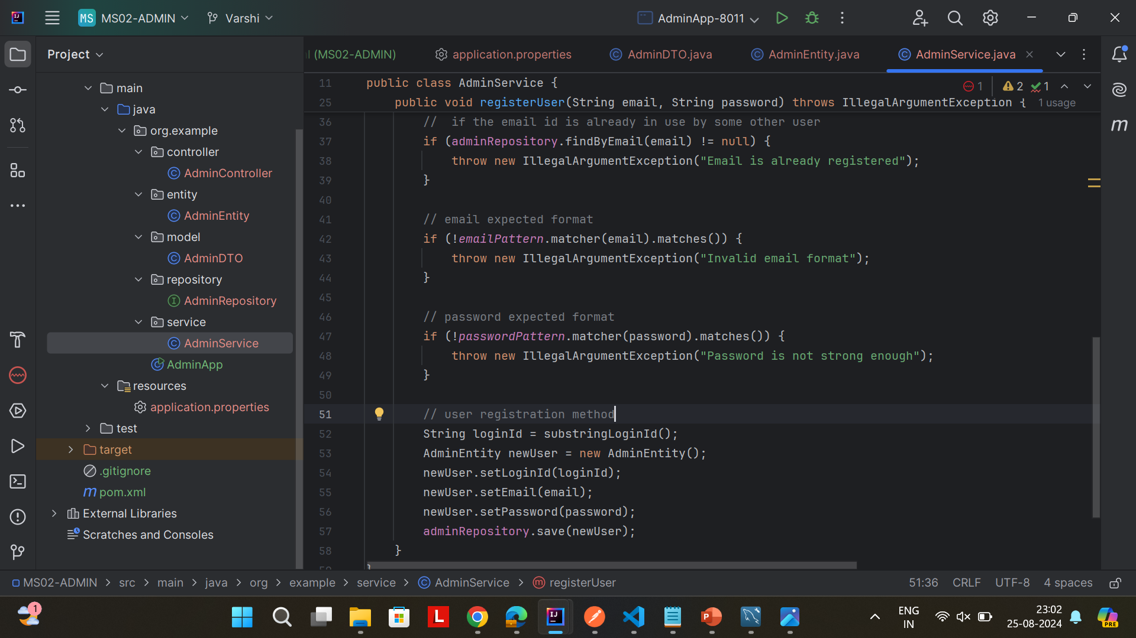
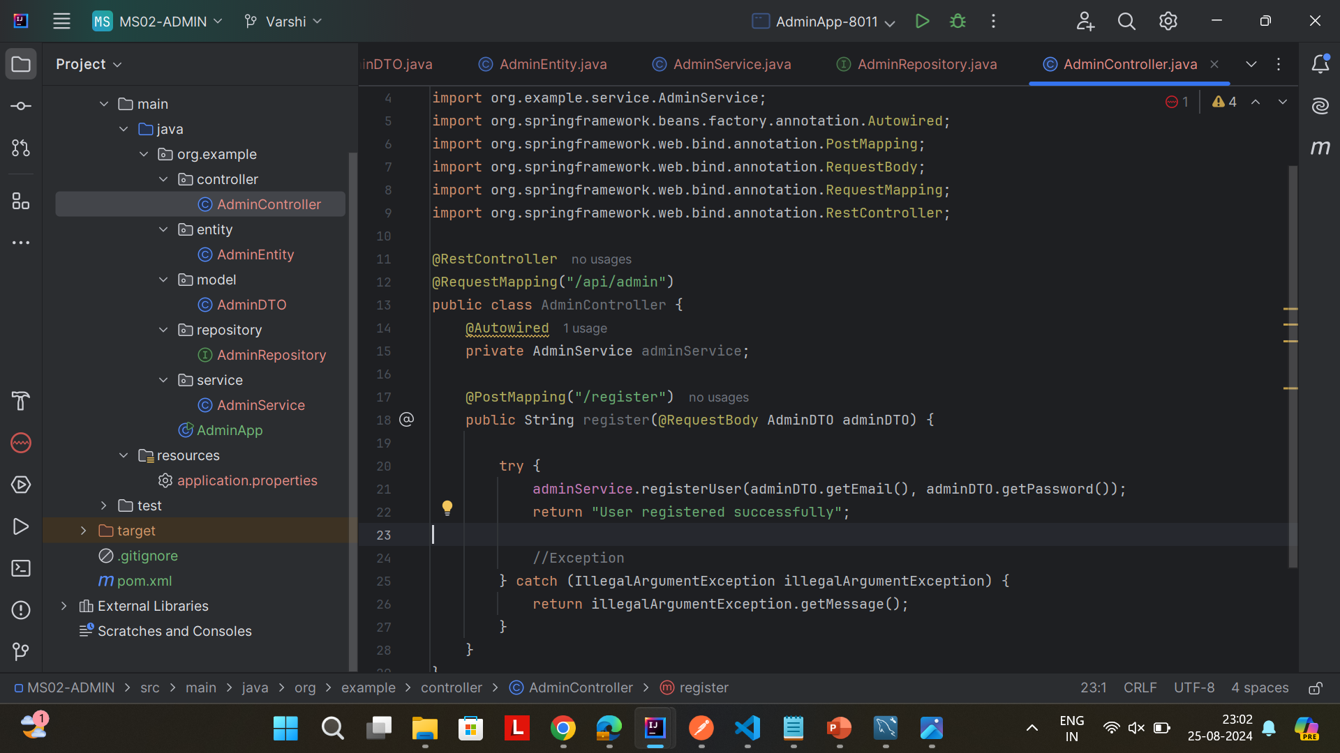
Project Screenshots
BOOKING MICROSERVICES

Slide 9
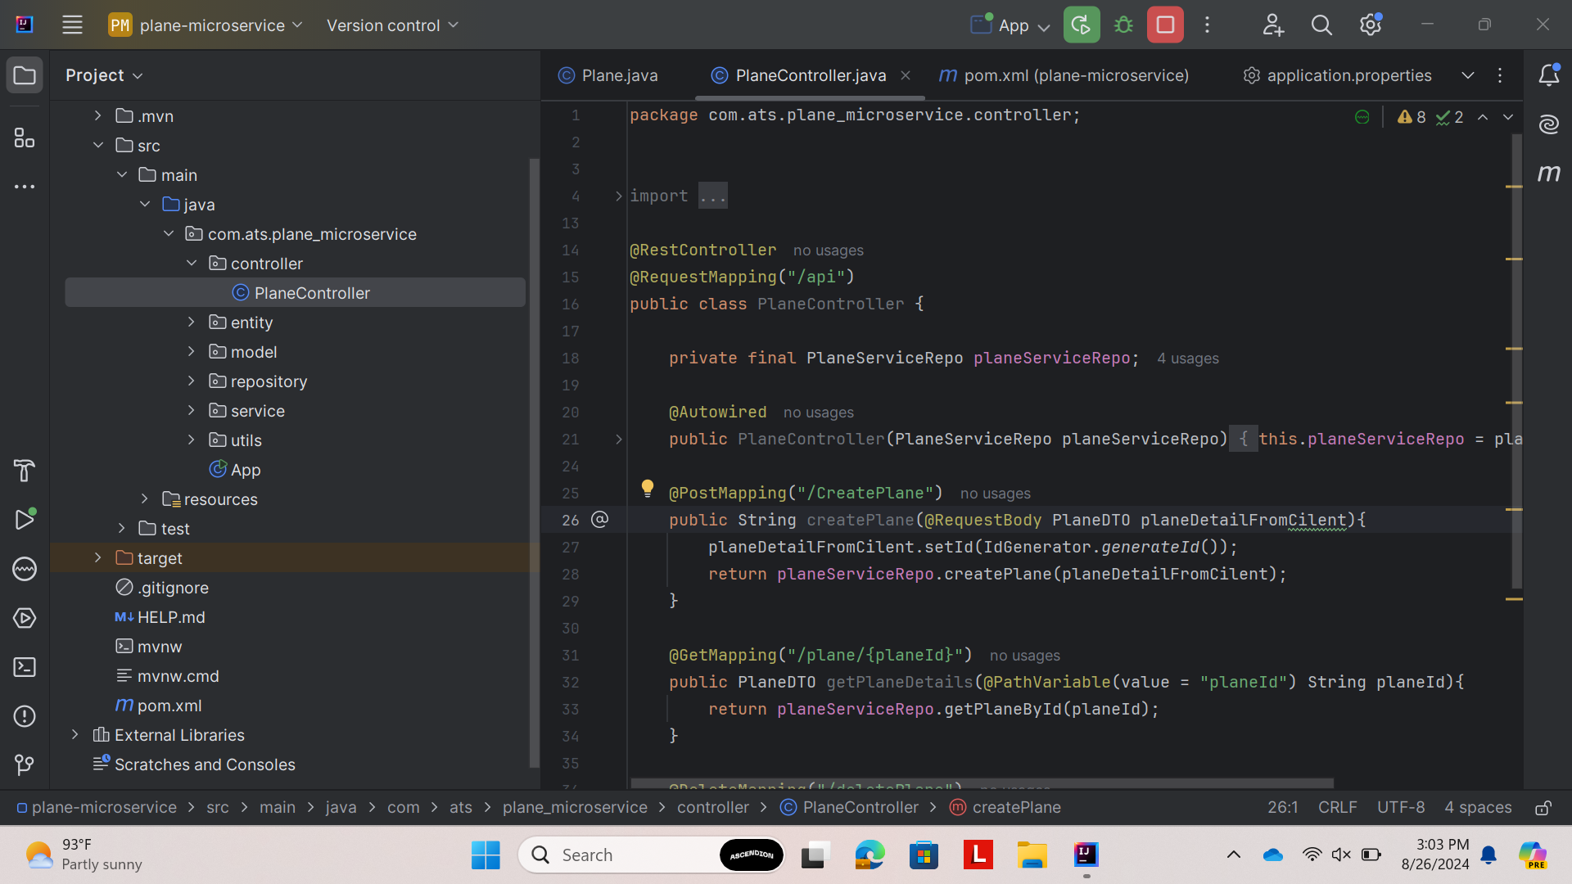
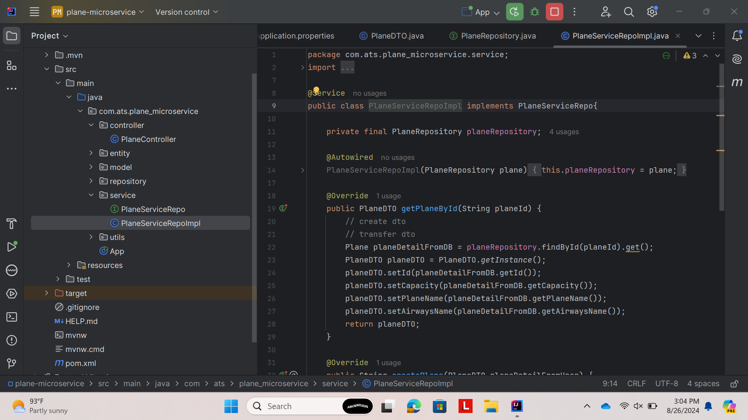
Project Screenshots
PLANE MICROSERVICES

Slide 10
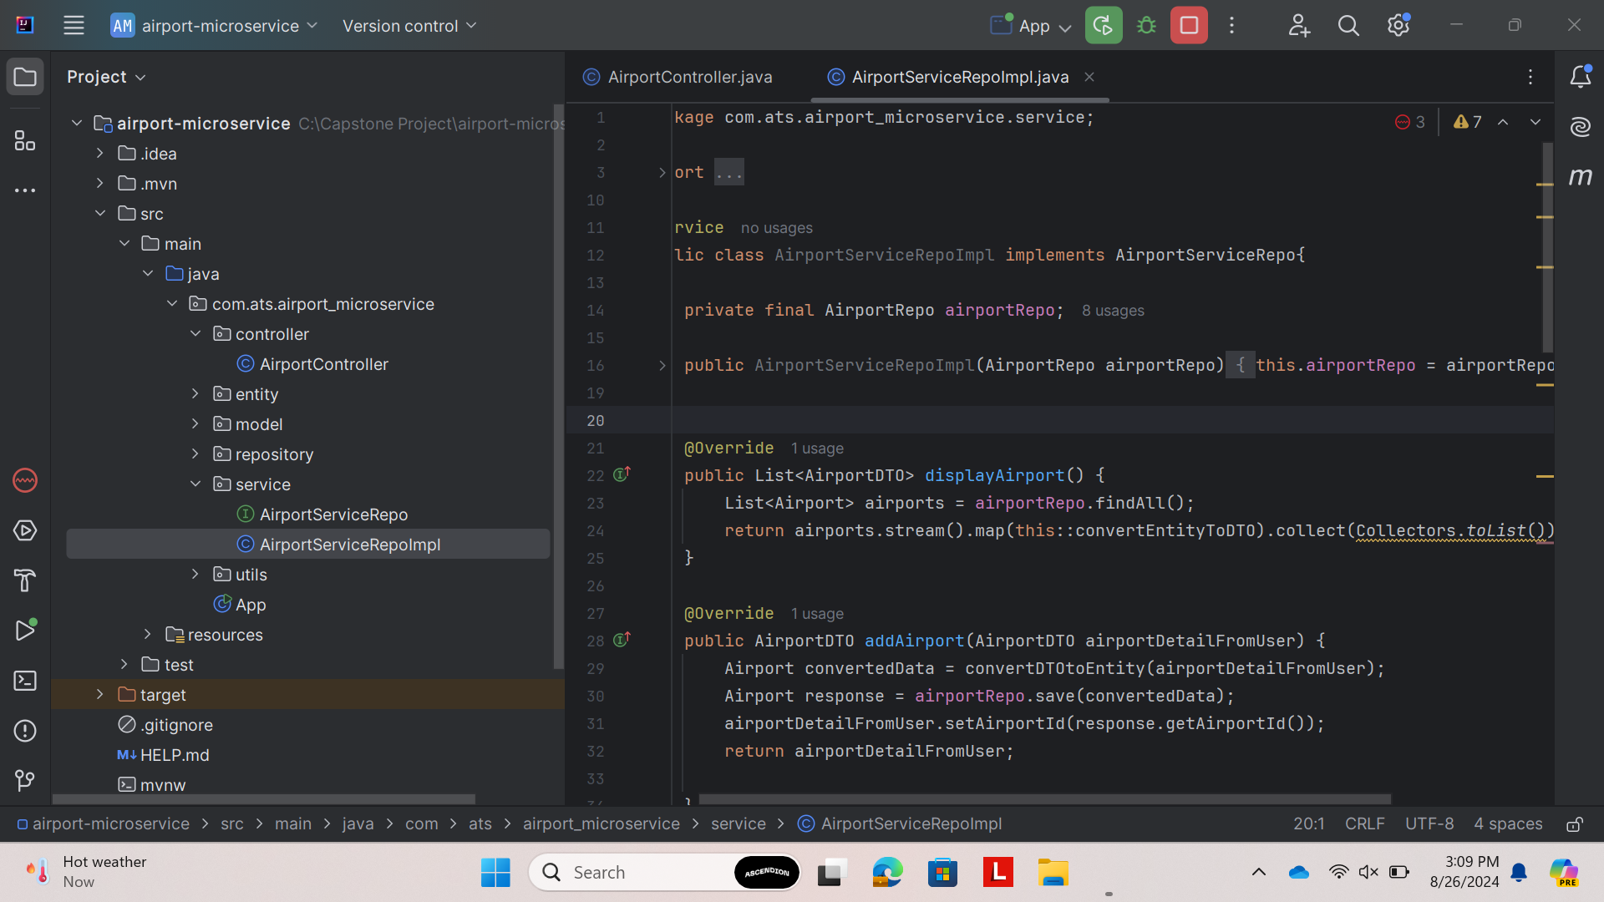
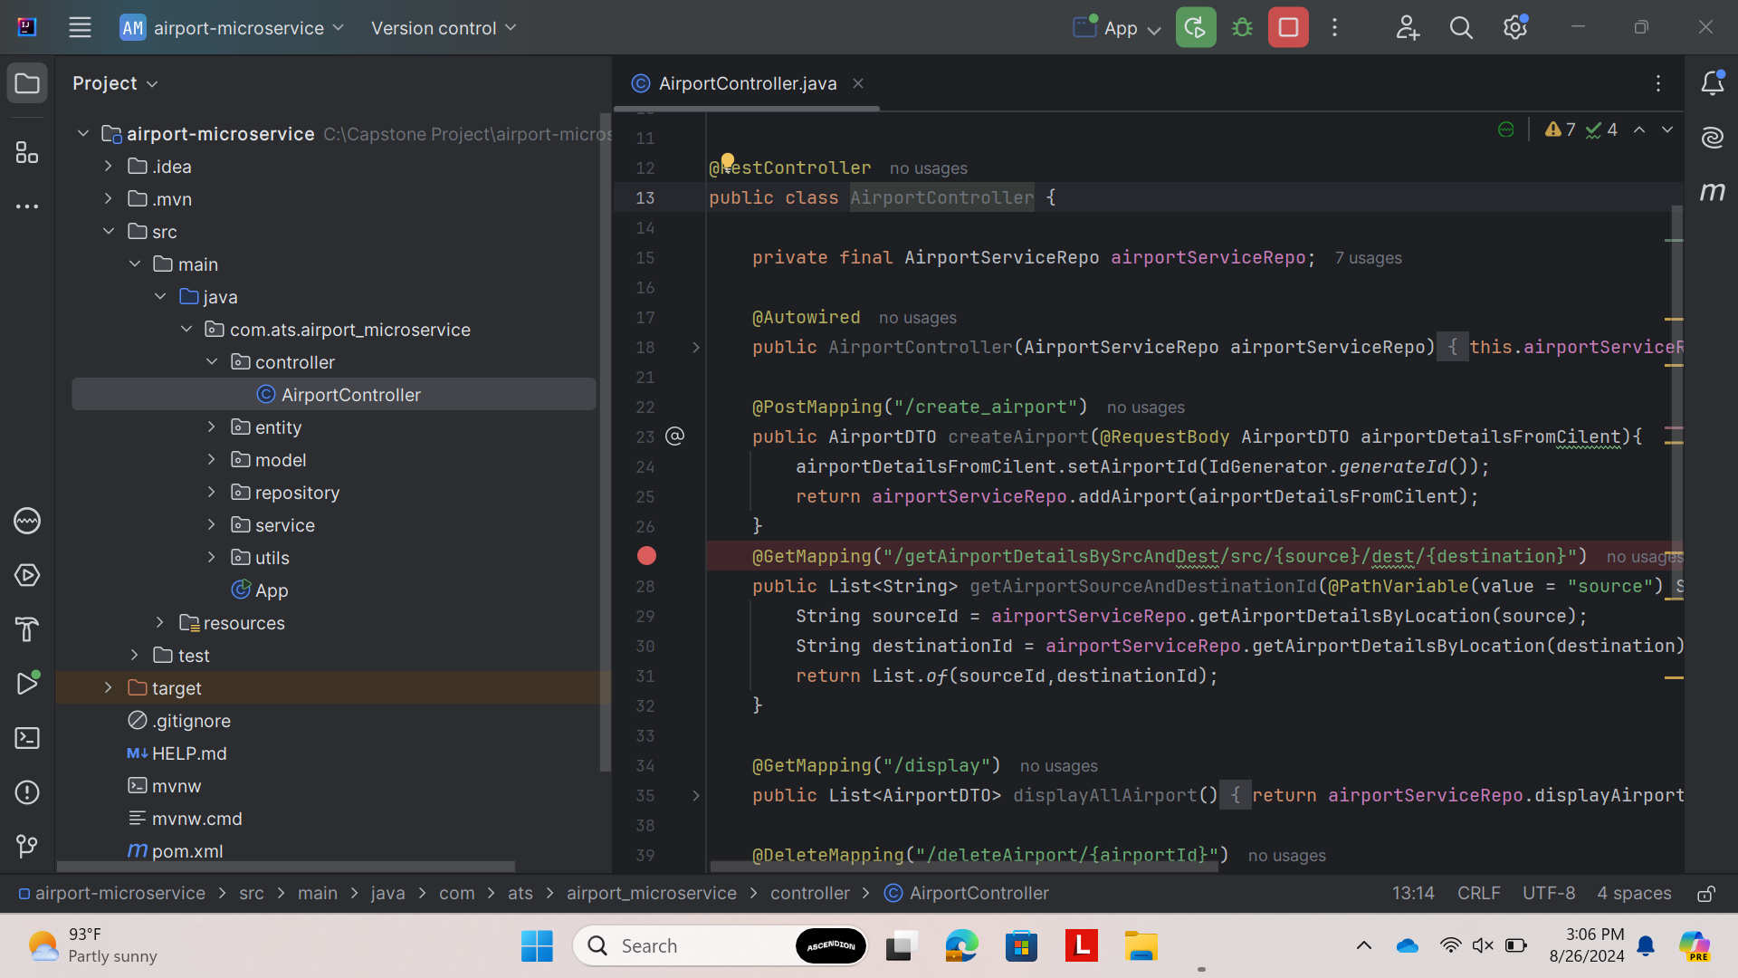
AIRPORT MICROSERVICES

Slide 11
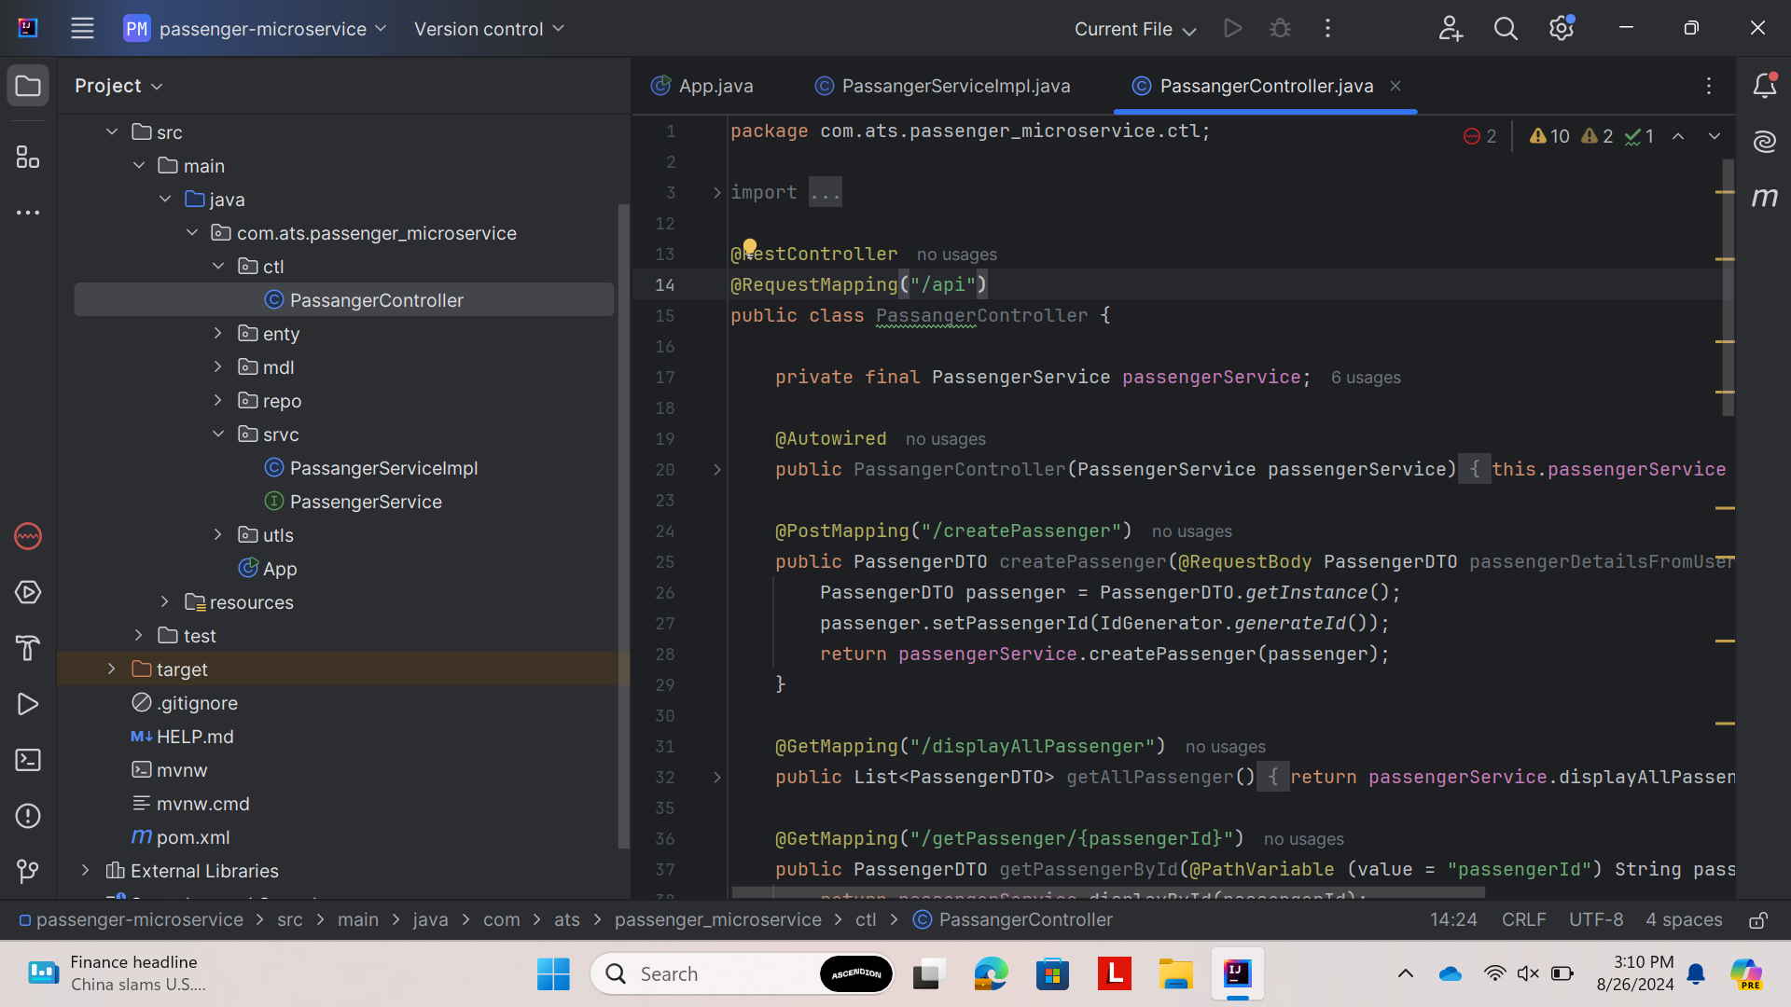
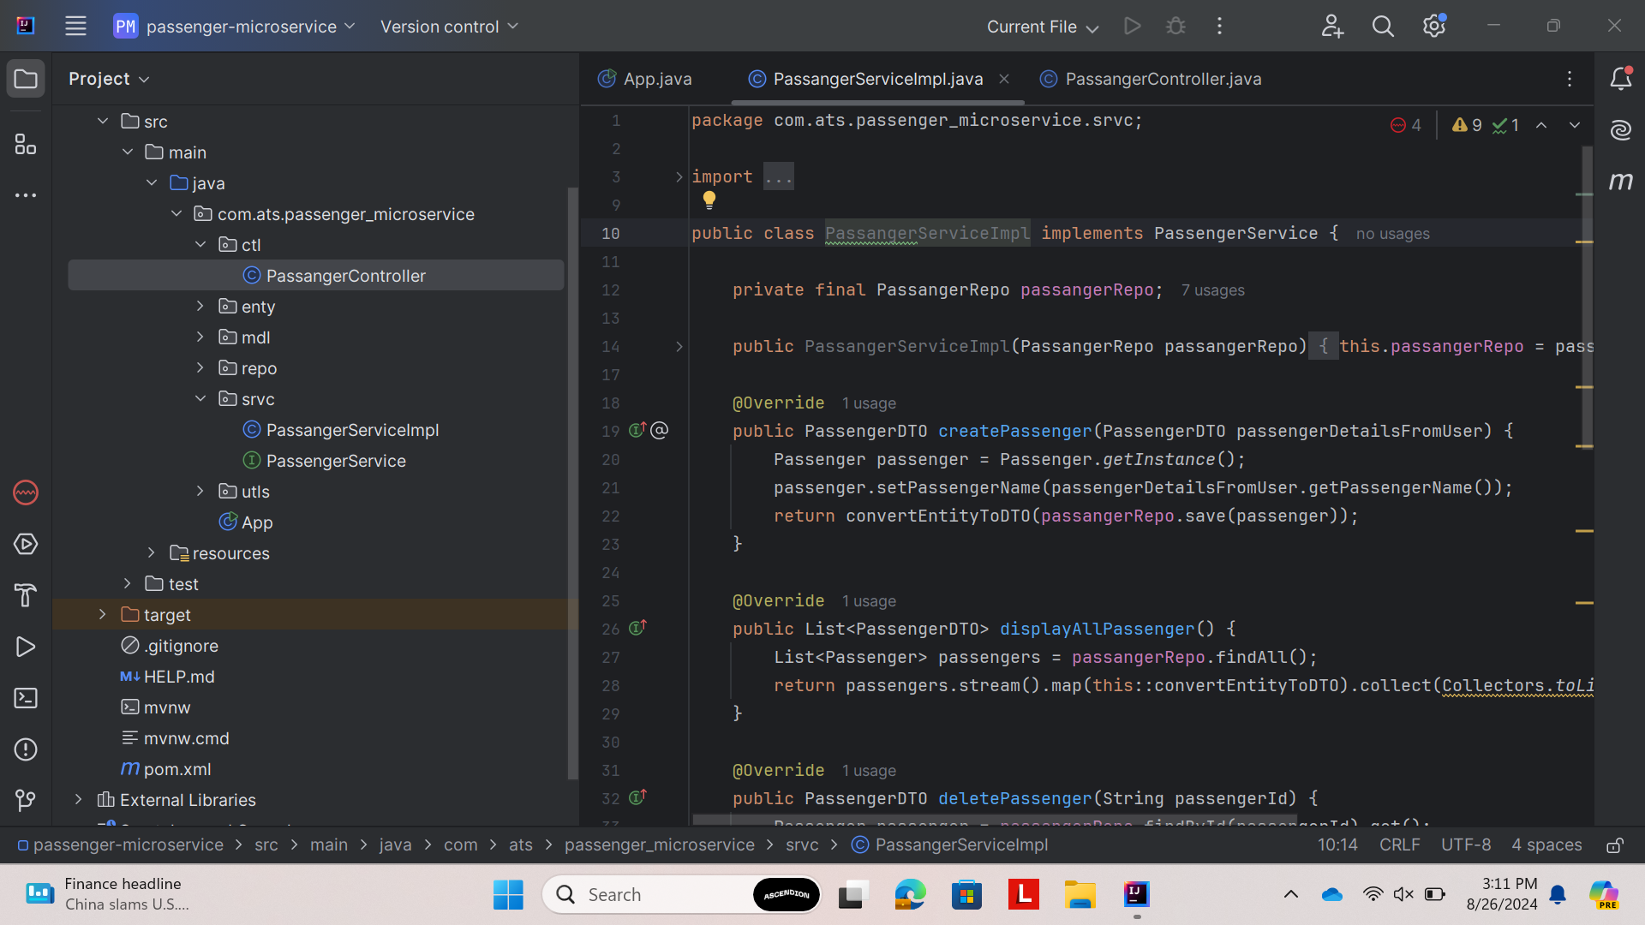
PASSENGER MICROSERVICES

Slide 12
Conclusion
Comprehensive Backend Solution: Developed a robust Spring Boot-based backend system for air transport management, featuring complete CRUD operations for planes, airports, bookings, and user authentication.
Effective Technology Integration: Successfully implemented and demonstrated proficiency in Spring Boot, Hibernate, REST API, JPA, and Maven, showcasing practical application of these technologies in a real-world project.
Microservices Architecture: Designed and implemented multiple microservices (login, booking, plane, and airport services) with specific functionalities, effectively integrating them to create a scalable and maintainable air transport management system.

Slide 13
Thank You

